Slide 1
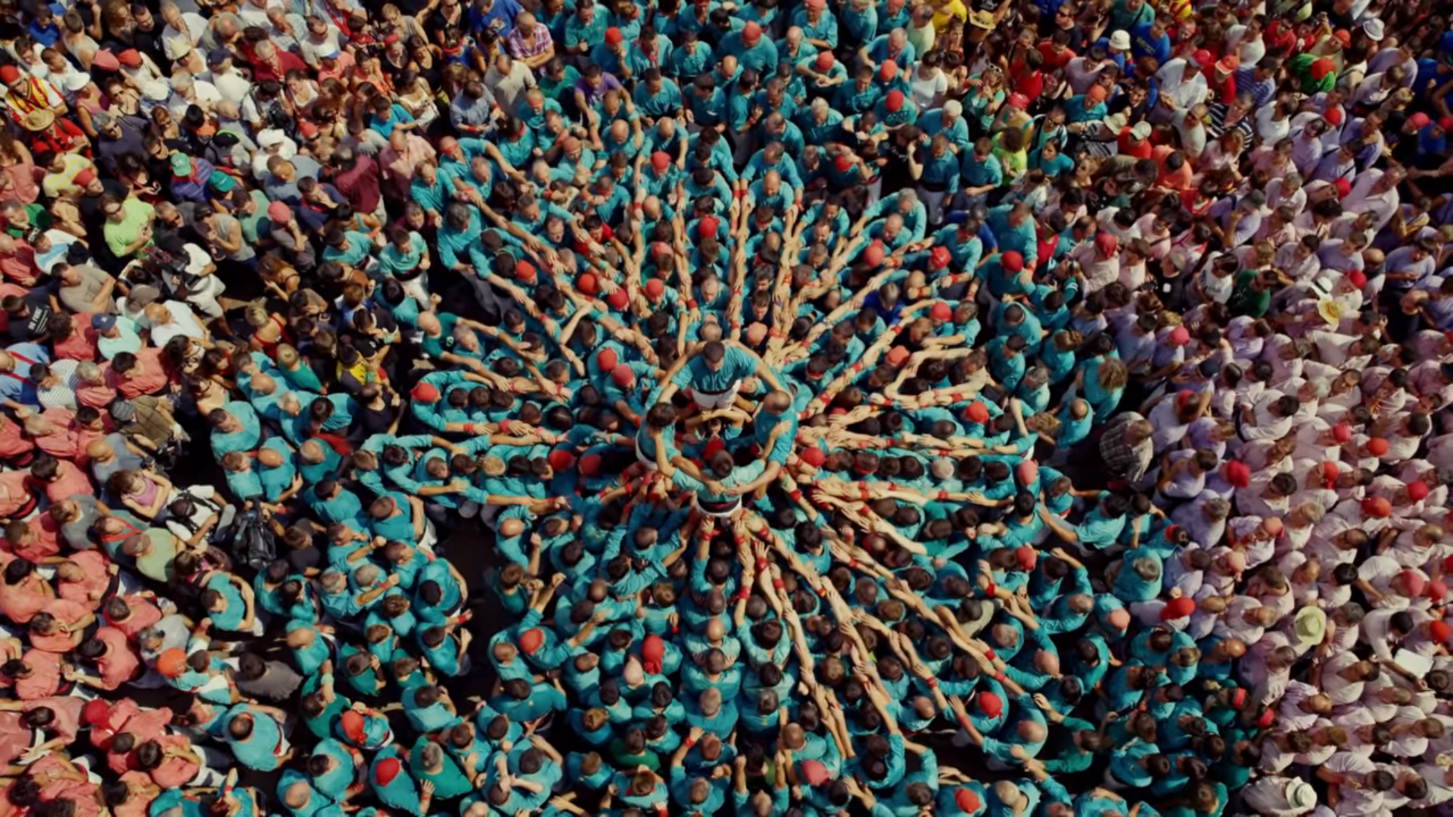
UNCHARTED
Understanding, Capturing and Fostering the Societal Value of Culture
UNCHARTED project has received funding from the European Union’s Horizon 2020 research and innovation programme, under grant agreement No 870793.
The sole responsibility for the content of this website lies with the UNCHARTED project.

Slide 2
Project Identity Card
Project acronym: UNCHARTED
Project theme: H2020-SC6-TRANSFORMATIONS-2018-2019-2020/H2020-SC6-TRANSFORMATIONS-2019
Start date:1st February 2020
Duration: 48 months
EU Grant: 2,999,716.25 EURO
Web site: www.uncharted-culture.eu
Contacts:
Project Coordinator: Prof. Rodríguez Morató, rodriguez.morato@ub.edu
Network and Communication: Antonella Fresa, fresa@promoter.it
Communication & Dissemination Team: dissemination-uncharted@promoter.it
UNCHARTED project has received funding from the European Union’s Horizon 2020 research and innovation programme, under grant agreement No 870793.
The sole responsibility for the content of this website lies with the UNCHARTED project.

Slide 3
Project Participants
10 Partners from 7 EU Countries:
University of Barcelona (Coordination), Spain
Eötvös Loránd Tudomanyegyetem, Hungary
University of Coimbra, Portugal
University of Bologna, Italy
Telemark Research Institute, Norway
CNRS, France
University of Porto, Portugal
Goldsmiths, University of London, UK
University Paris 8, France
Promoter, Italy
UNCHARTED project has received funding from the European Union’s Horizon 2020 research and innovation programme, under grant agreement No 870793.
The sole responsibility for the content of this website lies with the UNCHARTED project.

Slide 4
Project Objectives
The project aims to contribute to the understanding and management of the multiple values of culture and to develop tools and guidelines for the reorientation of cultural policy in a consequent pluralistic sense.
Main objectives:
to provide a broader vision of the values of culture in Europe
to identify the plurality of values that emerge in cultural practices
to understand, evaluate, measure and improve statistical data for capturing the plurality of values of culture
to assess the strategies and effectiveness of cultural policy and institutions in taking full advantage of the potential benefits of culture for society
UNCHARTED project has received funding from the European Union’s Horizon 2020 research and innovation programme, under grant agreement No 870793.
The sole responsibility for the content of this website lies with the UNCHARTED project.

Slide 5
Project impact
The social values of culture are multiple:
Cultural participation produces many different benefits such as inclusion, social cohesion, urban regeneration, innovation, creativity
and culture plays a decisive role in economic development
UNCHARTED aims
to identify and contextualize the emergence and conformation of the values of culture in Europe from an interdisciplinary and pluralistic perspective
to provide analytical and methodological tools to understand, measure and analyse the value of culture in Europe from a pluralistic sense.
However, often, the plural strategic value of culture is obscured by the economic perspective
UNCHARTED project has received funding from the European Union’s Horizon 2020 research and innovation programme, under grant agreement No 870793.
The sole responsibility for the content of this website lies with the UNCHARTED project.

Slide 6
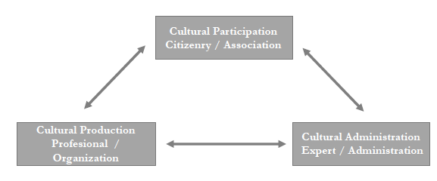
Project Area of work
UNCHARTED distinguishes three main areas and three types of fundamental actors in the value dynamics of culture:
the field of cultural participation, in which citizenship is the protagonist;
the field of cultural production and heritage, where the professionals of creation and preservation take the initiative;
the field of cultural administration, where the experts and politicians decide.
These three areas and this basic typology of actors are the starting point to structure the evaluative dynamic of values: the emergence of values, the configuration of a value order and the political impulse of values.
UNCHARTED project has received funding from the European Union’s Horizon 2020 research and innovation programme, under grant agreement No 870793.
The sole responsibility for the content of this website lies with the UNCHARTED project.

Slide 7
Project Outcomes
UNCHARTED will deliver a set of instruments to share the results of its investigation:
Policy briefs and recommendations for the use of policy makers
Guidelines and examples of best practices for communities engaged with production, management and use of culture
Case studies, scientific papers and a wide range of practical resources made available to researchers
The UNCHARTED book
The plan for a major event open to the whole UNCHARTED community, to be organised after the successful conclusion of the EU funded period
UNCHARTED project has received funding from the European Union’s Horizon 2020 research and innovation programme, under grant agreement No 870793.
The sole responsibility for the content of this website lies with the UNCHARTED project.

Slide 8
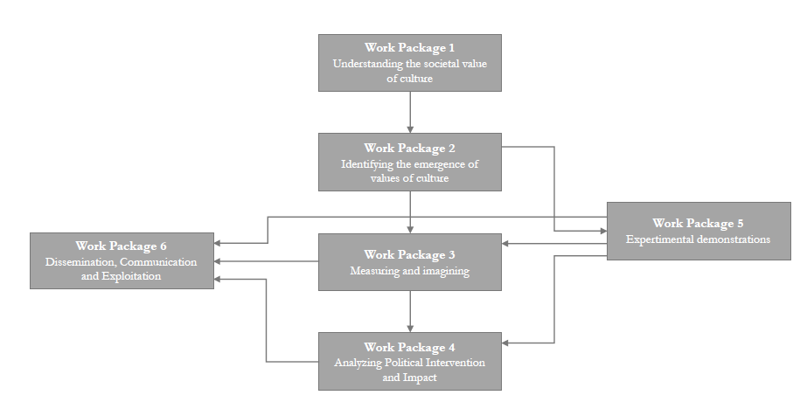
Project Methodology
The work has been divided into 8 work packages, each of them with a leader responsible for the tasks and deliverables associated with the WP.
UNCHARTED project has received funding from the European Union’s Horizon 2020 research and innovation programme, under grant agreement No 870793.
The sole responsibility for the content of this website lies with the UNCHARTED project.

Slide 9
The research work packages

Slide 10
WP1: Understanding the societal value of culture
Task leader: University of Barcelona
Basic areas that we will explore:
Gender and rising diversity
Urbanisation, spatial and social segregation
Globalization and digitization
Neo-liberalism
The historical experience: the role of culture in integrating and dividing Europe
Specific objectives:
To make an extensive review of the research literature and existing data on the configuration of the values of culture
To assess the influence of several key factors and circumstances in the configuration of the social values of culture
To synthesise the previous analysis in a global view about the factors configuring the values of culture in Europe
UNCHARTED project has received funding from the European Union’s Horizon 2020 research and innovation programme, under grant agreement No 870793.
The sole responsibility for the content of this website lies with the UNCHARTED project.

Slide 11
WP2: Identifying the emergence of values of culture
Task leader: University of Porto
Processes are studied in 3 main frameworks:
the frame of cultural participation of citizenship
the framework of specialized cultural production and preservation
the framework of the new world of digital cultural communication
Another area of inquiry correspond to the field of cultural policy and administrations.
The project will study the formulation of missions and agendas of objectives.
Specific objectives:
to identify the plurality of values of culture in cultural participation in live arts and culture
to identify the plurality of values of culture in cultural participation through media
to identify the plurality of values of culture in cultural production and heritage management
to identify the plurality of values of culture in cultural administration identify tensions, conflicts and public controversies in these four domains
UNCHARTED project has received funding from the European Union’s Horizon 2020 research and innovation programme, under grant agreement No 870793.
The sole responsibility for the content of this website lies with the UNCHARTED project.

Slide 12
WP3: Measuring and imagining
Task leader: University of Bologna
The focus will be placed on three basic drivers of the cultural matrix:
the citizens involved in cultural participation activities
the experts and cultural professionals collaborating in cultural production and preservation
the policy-makers representing, intervening and regulating culture
Specific objectives:
To analyse the grammars of valuation and evaluation in cultural practices
To analyse the practices of evaluation in cultural production and heritage management
To understand how do public administration evaluation methodologies influence cultural production and heritage management
To investigate the representations of cultural value in cultural information systems
To create a view of the societal value of culture
UNCHARTED project has received funding from the European Union’s Horizon 2020 research and innovation programme, under grant agreement No 870793.
The sole responsibility for the content of this website lies with the UNCHARTED project.

Slide 13
WP4: Analyzing political intervention and impact
Task leader: CNRS
There are two areas to investigate in this WP followed by a conclusive reflection:
Cultural policy configurations and strategies fostering the plurality of values of culture
Cultural policy configurations and strategies fostering cultural diversity, equality and inclusiveness
Towards more complex and efficient cultural policy models
Specific objectives:
To provide a comprehensive analytical view of the cultural policy coherence in relation with the promotion of the values of culture both in an internal inter-territorial perspective and with respect to value configurations in society
To provide a comprehensive analytical view of cultural policy effectiveness and impact in fostering the plurality of values of culture and cultural diversity, equality and inclusiveness
To produce general policy guidelines in this domain, especially in relation with information systems and the assessment and evaluation systems that govern administrations and cultural institutions
UNCHARTED project has received funding from the European Union’s Horizon 2020 research and innovation programme, under grant agreement No 870793.
The sole responsibility for the content of this website lies with the UNCHARTED project.

Slide 14
Project Events
The program of events provided during the UNCHARTED project includes:
Two co-creation workshops (in Porto and in Barcelona) will combine the generation and sharing of knowledge with the creation of a common understanding and approach to the themes addressed by the research of UNCHARTED. For the occasion, 15-20 key experts will be invited.
One central event (in London) will include a co-creation workshop and a one-day public debate to present the findings of the project to a broader audience.
One policy seminar (in Brussels) where representatives of the European institutions as well as policy makers, at international, national and local levels will be invited to discuss and review policy brief, recommendations and guidelines, on the basis of the actual needs from the territories represented by the participating stakeholders.
UNCHARTED project has received funding from the European Union’s Horizon 2020 research and innovation programme, under grant agreement No 870793.
The sole responsibility for the content of this website lies with the UNCHARTED project.

Slide 15
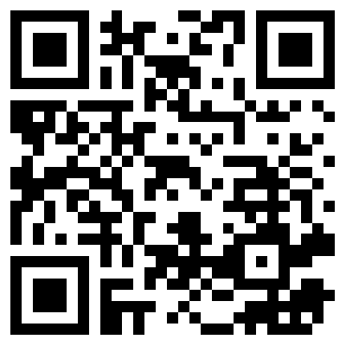
Contact Details
Follow UNCHARTED on: www.uncharted-culture.eu
@
Contact us at: dissemination-uncharted@promoter.it
UNCHARTED on Facebook: @uncharted.culture
www.facebook.com/uncharted-culture
UNCHARTED on Twitter: @uncharted_cult
https://twitter.com/uncharted_cult
UNCHARTED on LinkedIn: UNCHARTEDCULTURE Network
https://www.linkedin.com/groups/13829206/
UNCHARTED project has received funding from the European Union’s Horizon 2020 research and innovation programme, under grant agreement No 870793.
The sole responsibility for the content of this website lies with the UNCHARTED project.

